Slide 1

Sleep Health and Lifestyle Group Members: Katherine O’Malley Francis Sulkowski Gerald Dixon Lauren Matos May Hli Yang

Slide 2
Introduction

Slide 3
Why is Sleep Important?
Sleep plays a vital role in well being and good health
Healthy brain function and physical well being are supported during sleep
Learning and long term memories are helped with sleep
Sleep directly impacts the way one feels when awake PLUS how well one thinks, reacts, works, learns, gets along with others and more!
Recommended Sleep?
7 to 9 hours of sleep a night for adult
How Sleep Works - Why Is Sleep Important? | NHLBI, NIH ; How Sleep Works - How Much Sleep Is Enough? | NHLBI, NIH.

Slide 4
What Happens When You Don’t Get Enough Sleep?
Sleep aids in learning and the creation of long-term memories
Consequences of not not sleeping enough
Problems focusing on tasks
Unable to think clearly
Raises risk for chronic health problems
How Sleep Works - Why Is Sleep Important? | NHLBI, NIH

Slide 5
Questions:
How does BMI relate to sleep disorders?
Do different occupations influence sleep disorders?
Which gender has more sleep disorders?
Does increased age negatively/positively affect sleep duration?

Slide 6
Helpful Terms
What is BMI?
BMI is a calculated calculated measure of body weight relative to height
BMI Adult Categories are: underweight, healthy weight, overweight, and obesity
BMI is a calculation of a body person's weight (in kilograms) divided by the square of their height (in meters)

Slide 7
Helpful Terms
What is a Sleep Disorder?
Health conditions that prevent people from getting enough quality sleep, no matter how hard they try
What are common Sleep Disorders?
Insomnia
trouble falling asleep, staying asleep, or getting good quality sleep. This happens even if you have the time and the right environment to sleep well. Insomnia can get in the way of your daily activities and may make you feel sleepy during the day.
Sleep Apnea
common condition in which your breathing stops and restarts many times while you sleep. This can prevent your body from getting enough oxygen.

Slide 8
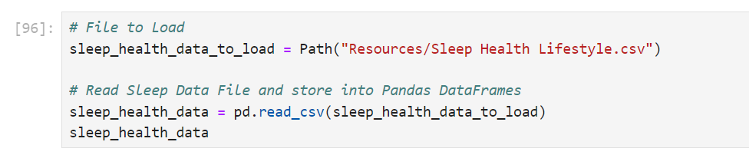
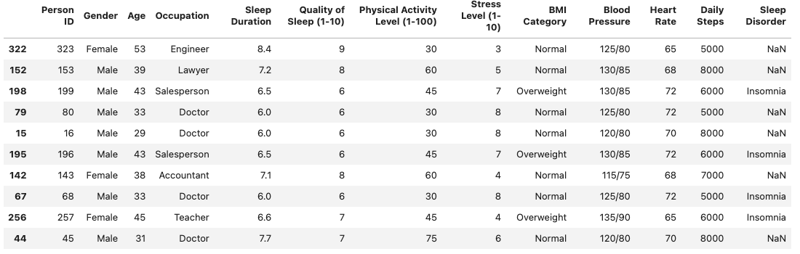
Dataframe
Overview

Slide 9
Question #1:
How does BMI relate to sleep disorders?

Slide 10

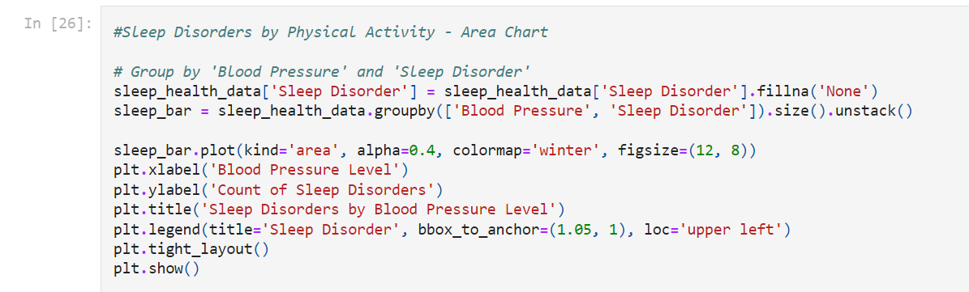
Code Snippet 1 - Area Chart

Slide 11
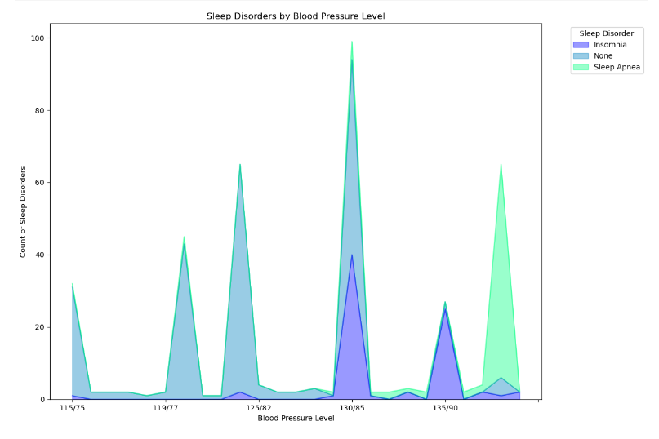
Sleep Disorders by Blood Pressure Level - Area Chart

Slide 12
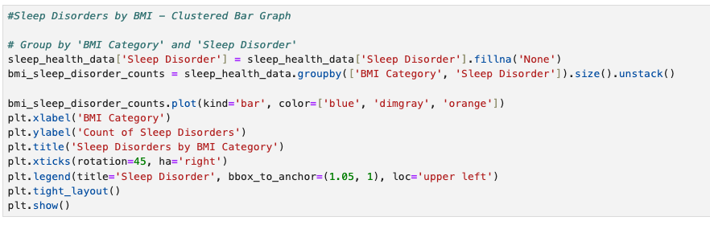
Code Snippet 2 - Clustered Bar Graph

Slide 13

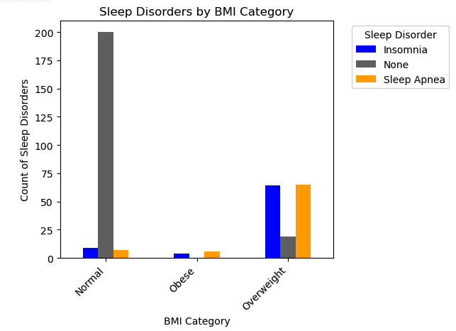
Sleep Disorders by BMI - Clustered Bar Graph

Slide 14
Analysis
Key findings:
- Abnormal blood pressure levels do relate to the sleep disorders
- Abnormal BMI levels show a significant relation to the sleep disorders
Area chart:
- Illustrates abnormal blood pressure levels with high peaks of sleep disorders such as sleep apnea
- Lower blood pressures show a higher range of no sleep disorders
Clustered bar graph:
- Normal BMI levels show a peak high of no sleep disorders
- Abnormal BMI ranges illustrate higher counts of sleep disorders
Conclusion:
- Yes, sleep apnea and high blood pressure are closely linked. Both conditions have high risks of other
- Abnormal BMI levels increase the risk of sleep disorders and have negative effects to overall health considering sleep and BMI are key roles to health

Slide 15
Question #2:
Do different occupations influence sleep disorders?

Slide 16

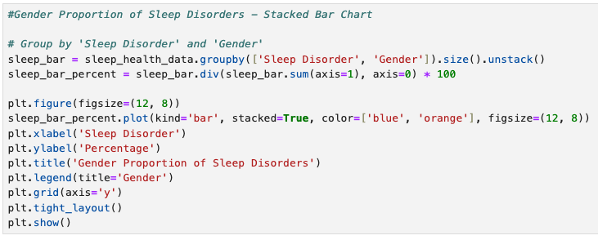
Code Snippet 3 - Stacked Bar Graph

Slide 17
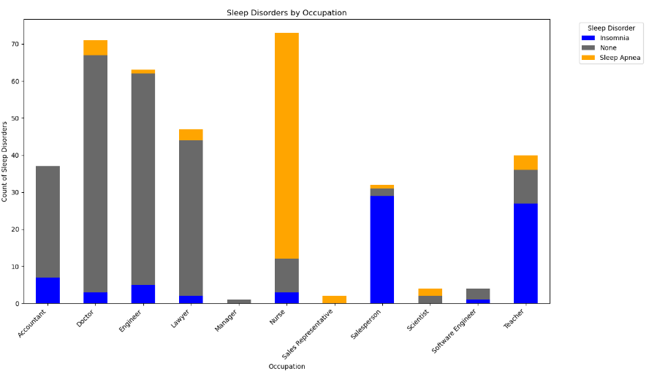
Sleep Disorder By Occupation - Stacked Bar Graph

Slide 18
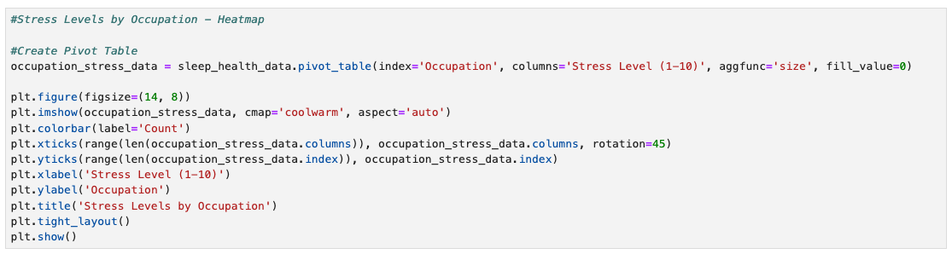
Code Snippet 4 - Heatmap

Slide 19
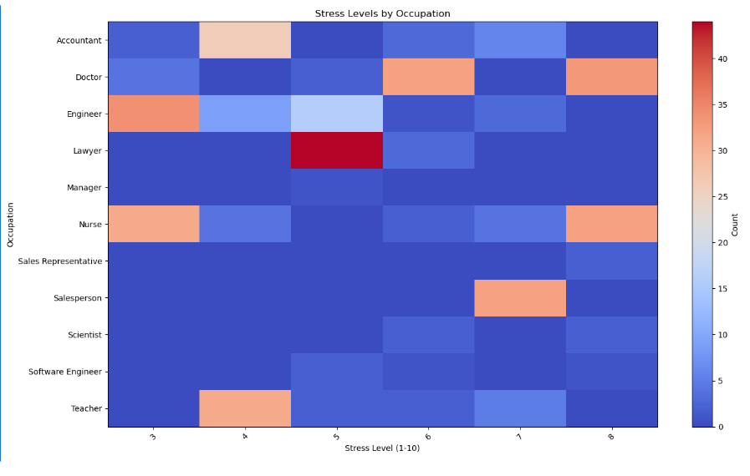
Stress Levels by Occupation - Heatmap

Slide 20
Analysis:
Key Findings:
Jobs with higher stress levels tend to have a greater prevalence of sleep disorders.
Nursing and sales are high-stress professions with high occurrences of sleep apnea and insomnia.
Engineering and law professions exhibit lower levels of stress and a correspondingly lower prevalence of sleep disorders.
Stacked Bar Graph Analysis:
Illustrates sleep disorders associated with different occupations.
Nurses have a high number of sleep apnea diagnosis.
Many sales professionals report insomnia.
Some occupations show a majority of individuals reporting no sleep disorders, like accounting, law and engineering.
Heatmap Analysis:
Illustrates stress levels associated with different occupations.
Nurses: Report some of the highest stress levels, aligning with higher sleep disorder rates.
Engineers: Have lower stress levels (around 3 out of 10), reflecting fewer sleep disorders.
Conclusion:
Higher stress levels in occupations are linked to a greater prevalence of sleep disorders.
Professions like nursing and sales, with significant stress and emotional strain, show higher rates of disorders like sleep apnea and insomnia.
Highlights the direct impact of job-related stress on sleep health.

Slide 21
Question #3:
Which gender has more sleep disorders?

Slide 22
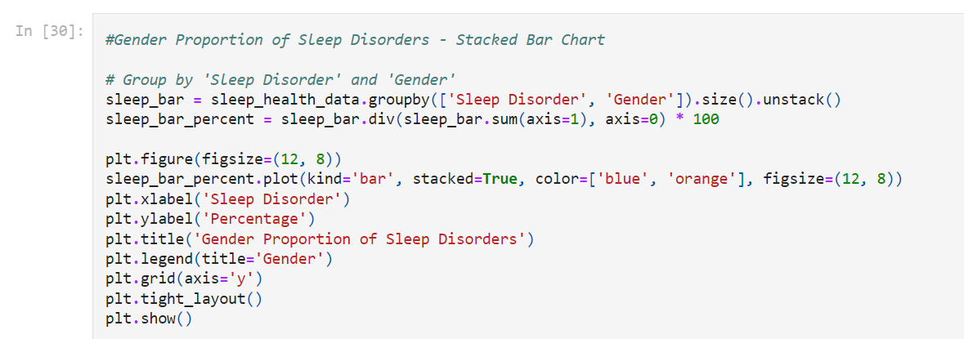
Code Snippet 5 - Stacked Bar Graph

Slide 23
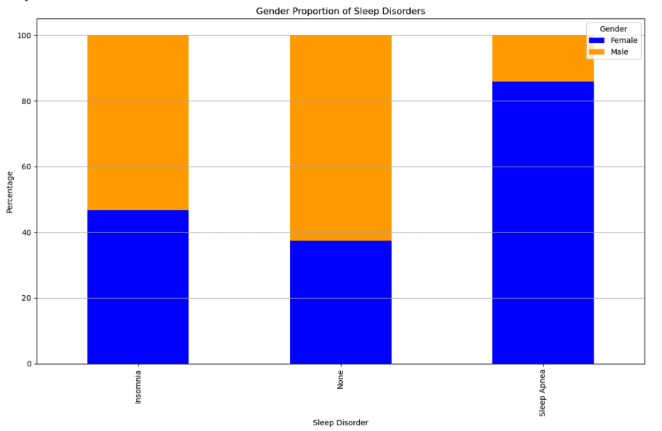
Percent of Sleep Disorders by Gender -
Stacked Bar Graph

Slide 24
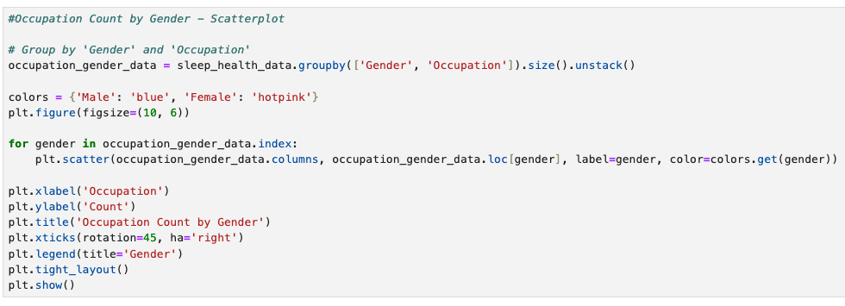
Code Snippet 6 - Scatterplot

Slide 25
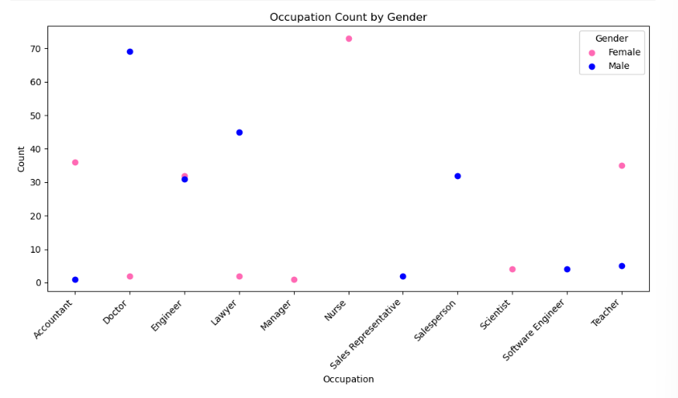
Occupation Count By Gender - Scatterplot

Slide 26
Analysis:
Key Findings :
Women are more prone to sleep disorders than men.
Occupation can clearly affect people's sleep.
Stacked Bar Chart of Sleep Disorders:
Women are more likely to have sleeping disorders, this can be due to several factors, including hormonal changes, housework, caregiving responsibilities, and juggling different responsibilities with work.
Scatter Plot Occupation by Count:
Men often are more likely to have occupations that are at a lower percentage of sleep disorders. Meanwhile, women are more likely to have occupations with a higher percentage of sleep disorders.
Conclusion:
Due to biological factors, caregiving responsibilities, and the impact with occupation, all these factors can contribute to higher or lower prevalence of sleep issues among genders.

Slide 27
Question #4:
Does increased age negatively/positively affect sleep duration?

Slide 28
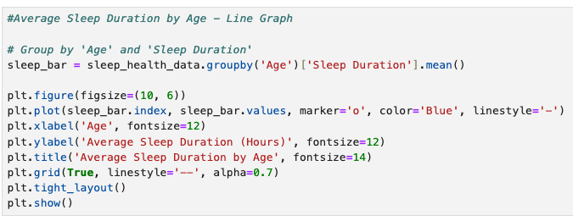
Code Snippet 7 -
Line Graph

Slide 29
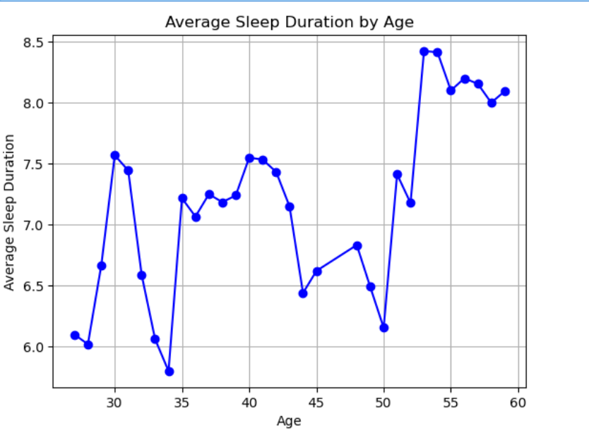
Average Sleep Duration by Age - Line Graph

Slide 30
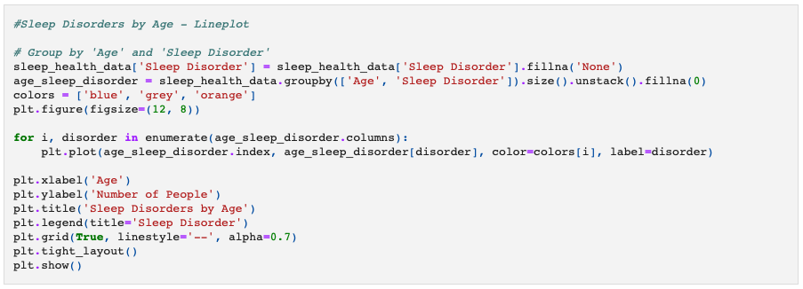
Code Snippet 8 -
Line Plot

Slide 31
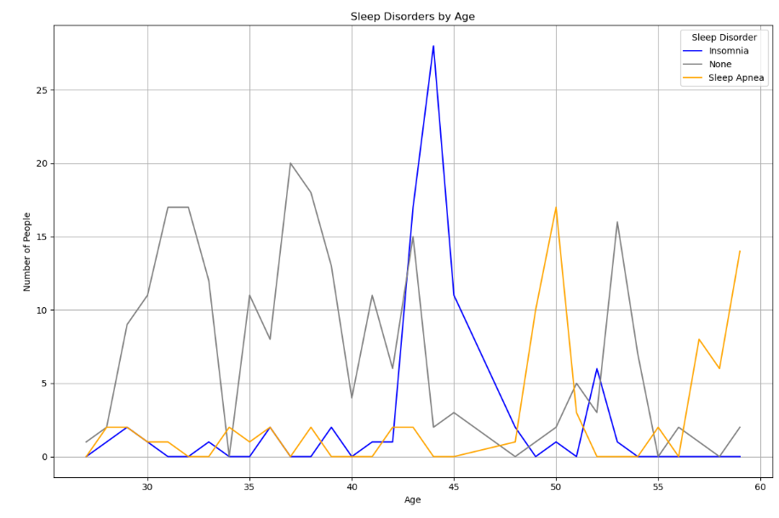
Sleep Disorders by Age – Line plot

Slide 32
Analysis:
From the early 20’s to the low 30’s we see an increase in sleep duration. This can be attributed to active lifestyles that someone between this age range has such as staying up late for school studying, caffeine, social activities, and work.
What’s also interesting is the Sleep Duration drop significantly between 30 and 35. On average, the American couple start to have children in between the ages of 27 through 36, so knowing that, it isn’t surprising to see the sleep duration numbers decrease within this age group. According to National Library of Medicine, this age group stage 3 rapid eye movement decreases by 2 percent from this time to the 60’s. And also around this time, you’re dealing with work schedules, family obligations, financial stress, and use of technology.
As for sleep disorders by age, we see between the ages of 40-48 dealing with sleep insomnia and it’s most likely because of menopause which is a change in how much estrogen women are producing which can affect mood, night sweats, and hot flashes.
Sleep apnea increases in the mid 40’s to the mid 50’s and again around age 60. This mostly by men due to weight increase, alcohol intake, and decreased physical activity.

Slide 33
The End

Slide 34
Sources
Why is Sleep Important?
Source: How Sleep Works - Why Is Sleep Important? | NHLBI, NIH
Recommended Sleep
Source: How Sleep Works - How Much Sleep Is Enough? | NHLBI, NIH.
BMI
Source: Adult BMI Categories
Sleep Disorders
Source: About Sleep | Sleep | CDC
Sleep Disorder - Insomnia
Source: What Is Insomnia? | NHLBI, NIH
Sleep Disorder - Sleep Apnea
Source: What Is Sleep Apnea? | NHLBI, NIHCDC Sleep Stats
United State Government Sleep Stats
Source: FastStats: Sleep in Adults
National Library of Medicine
Source: Causes of job stress in nurses: A cross-sectional study
National Council on Aging
https://www.ncoa.org/adviser/sleep/sleep-statistics/

Slide 35
Sources
Sleep Foundation
How Is Sleep Different For Men and Women?
PubMed Central (PMC)
Aging and Sleep: Physiology and Pathophysiology
ncoa.org
Think You Have Sleep Apnea? Here's How to Tell
Sleep Foundation
How Sleep Apnea Affects Blood Pressure
PubMed Central (PMC)
Body mass index and sleep disturbances: a systematic review and meta-analysis

